Slide 1

Bedford Borough’s Labour Market:
Q1 2025/26

Slide 2

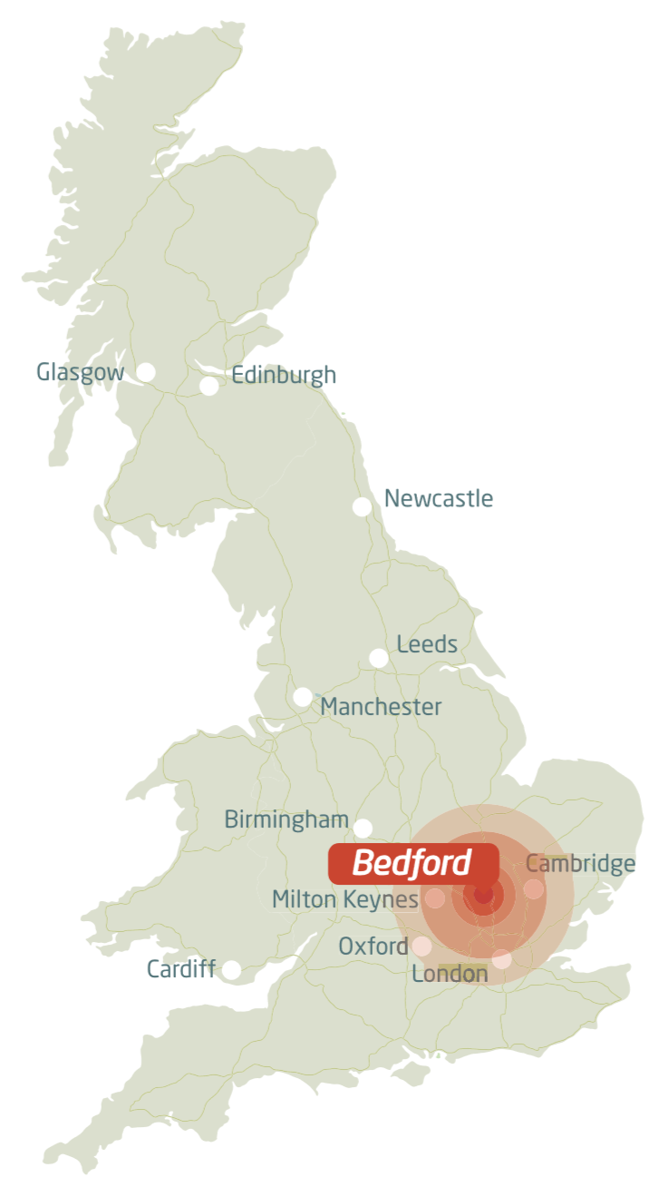
Bedford Borough’s Economy: Key Statistics
82,000 employee jobs
Over 8,000 businesses
Key Sectors:
- Logistics
- Advanced Engineering
- Creative
- Food & Drink
Source: NOMIS. Data extracted 23-07-2025

Slide 3

Bedford Borough’s Economy: Yearly Comparison
 |  | 2024/ 1 year prior | 2025/ Most up to date | Movement
Total Population |  | 174,700 | 185,800 | Up
Total working age population |  | 106,400 (60.9%) | 117,400 (63.2%) | Up
% of the working age population that are in employment |  | 82% | 78.2% | Down
% of the working age population qualified to Level 4+ |  | 53.0% | 44.3% | Down
Unemployment rate |  | 4.0% | 4.3% | Up
Claimant rate |  | 4.0% | 4.7% | Up
Gross Weekly Pay (mean) | By resident | £823.7 | £858.70 | Up
 | By workplace | £718.8 | £768.0 | Up
Source: NOMIS. Data extracted on 23-07-2025

Slide 4

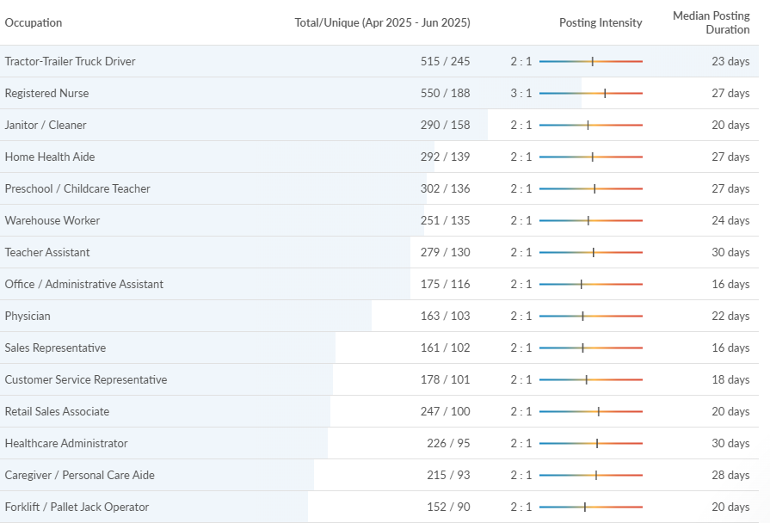
Job Market: Most Advertised Jobs
Source: Lightcast 23/07/2025

Slide 5
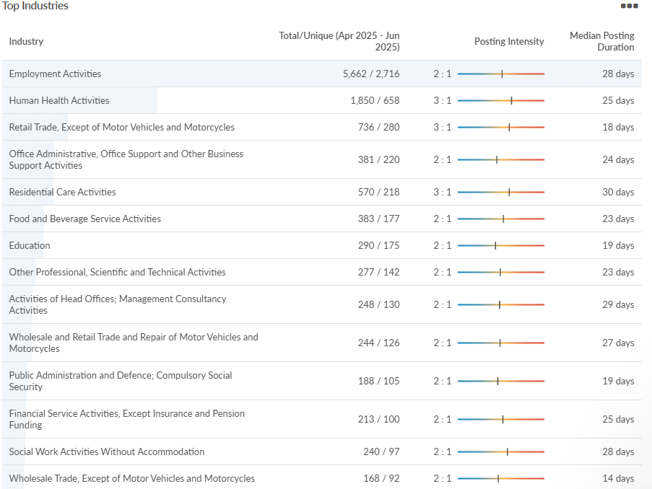
Job Market: Top Advertised Industry
Source: Lightcast 23/07/2025

Slide 6
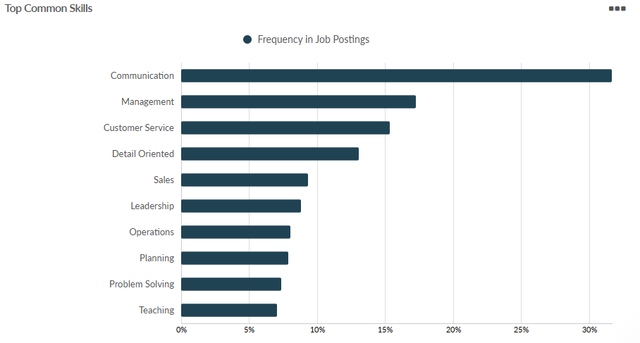
Job Adverts: Top Common Skills
Source: Lightcast 23/07/2025

Slide 7
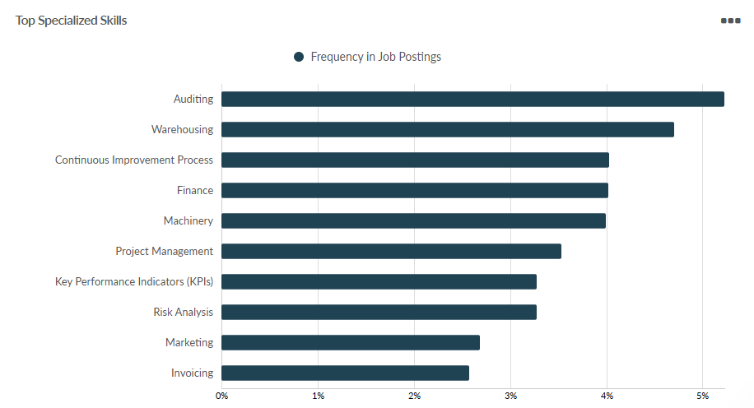
Job Adverts: Top Specialised Skills
Source: Lightcast 23/07/2025

Slide 8
Employability Skills
Basic Skills
Literacy
Numeracy
Spoken English
Basic Digital
Core Transferable Skills
  Communication
  Organisation
  Digital literacy
  Planning
  Problem solving
  Creativity/Innovation
  Leadership
  Time management
  Analytical
  Teamwork/Collaboration
  Resilience
Attitudes & Behaviours
Detail orientated
Work ethic
Willingness to learn
Enthusiasm
Self-motivation
Independent working
Flexibility
Adaptability
Honesty
Reliability
Politeness
Humility
Empathy
Curiosity
Job specific
Operations
Customer service
Sales
Management
Specialist digital skills
Commercial acumen
Financial awareness
Working with hands
Driving
Technical/Vocational Skills
Qualifications and Certification
*Digital literacy defined as: Excel, Outlook, PowerPoint, Word, Teams
*Basic digital is defined as: search online, access a bank account, sending/receiving emails.
*Spoken English includes ESOL

Slide 9

Bedford Borough’s Economy:
Key Investments and Developments
Two New Town Centre Businesses
Heavenly Desserts, opposite the John Howard statue, is a national brand which opened its doors in 2008 and ‘has led the way in dessert dining’. The new business now has more than 50 branches in the UK with the aim of delivering memorable dessert experiences. It’s also proud to have become recognised as the UK’s fastest-growing dessert brand through its signature creations, such as the revolutionary Croffle, to being crowned ‘Best Dessert Restaurant’ by Deliveroo.
Furniture Outlet signed a five-year lease on the 26,000 sqft ground floor on the former Wilko store site in the High Street. A small section of the shop front has been retained (circa 500 sq ft) and, once planning has been granted another retail unit will be available to let.
The two upper floors of the three-storey building – vacant since the collapse of the budget homeware chain in 2023 – are expected to be redeveloped for residential use.

Slide 10

Bedford Borough’s Economy:
Conclusion
Truck drivers, cleaners and nurses are the most advertised jobs this quarter.
Range of employability skills that employers are looking for, including but not limited to qualifications only.
Bedford’s claimant count is now at 4.7%.

Slide 11
LMI Statistics Definitions
Total working age population:
% of the working age population that are in employment
Gross Value Added (GVA)
This is the number of 16-64 year olds living within the Borough boundary, who are in employment. This is taken from the Annual Population Survey from the Office of National Statistics. This is updated every quarter but as a whole year, for example January 2020- December 2020.
GVA is the measure of the value of goods and services produced in an area, industry or sector of an economy. The GVA used is current price by industry. This is taken from ONS and is updated annually but is often delayed (2019 released in 2021).
This is the number of 16-64 year olds living within the Borough boundary. This is taken from the Annual Population Survey from the Office of National Statistics (ONS). This is updated every quarter but as a whole year, for example January 2020- December 2020.
% of the working age population qualified to Level 4/ No qualification
Business Numbers
Job Numbers
This is the number of businesses in Bedford Borough at the time data was collected. These are sorted into:
Micro (0-9 employees)
Small 10-49 employees)
Medium (50-249 employees)
Large (250+ employees)
This is from the Inter Departmental Business Register, from ONS, and is released yearly.
This is the number of 16-64 year olds living within the Borough boundary, who have the related level of qualification. This is taken from the Annual Population Survey from the Office of National Statistics, this is updated once a year.
This is the number of employee jobs by sector. This is taken from the ONS Business Register and Employment Survey and is updated yearly.
These are sorted into the ‘type’ of job, eg administration or manufacturing.

Slide 12
LMI Statistics Definitions
Unemployment rate
Claimant count
The unemployment rate consists of those people, aged 16-64 years who are out of work, who are actively looking for work and are available to start immediately. The data is taken from the Annual Population survey from ONS.
The results are model based and uses the APS results to do this, where a percentage of the population is interviewed and results extrapolated to the whole population. This is updated every quarter but as a whole year, for example January 2020- December 2020.
The Claimant Count is the number of people who are receiving benefits principally for the reason of being unemployed. This includes Job Seekers Allowance and Universal Credit.
This is released every month detailing information from the month prior.
Unemployment Rate vs Claimant Count
There is a large degree of overlap between the claimant count and unemployment rate. In some circumstances people can claim benefits while they have relatively low earnings from part time work; these claimants in a paid job would not appear in the model based measure of unemployment.
Similarly claimants of unemployment benefits may not appear in the model based measure if, when interviewed for the survey, they stated that they are not seeking, or are not available to start work. Both of these types of people would appear within the Claimant Count but would not be classified as unemployed.
Similarly, people who are not claimants can appear among the model based unemployed if they are not entitled to, or choose not to claim unemployment benefits. For example:
People whose partner was working
People who are looking for work alongside full-time study
People beyond or around State Pension Age who are looking for work.

